Slide 1
DATA MANAGEMENT CARPENTRY · EPISODE 1
Introduction to Data Management
Why data management matters in research, understanding file systems, and introducing our inherited project scenario.

Slide 2
EPISODE SCOPE
Questions & Objectives
Core Questions
Learning Objectives
Why is data management important?
Describe common data management challenges.
How do computers organise files?
Explain file and folder organisation.
What is a file system?
Navigate file systems via graphical interfaces.
How to navigate with a file explorer?
Locate project data in a file explorer.

Slide 3
CURRICULUM ROADMAP
Working from the Outside In
STEP 1 & 2
STEP 3 & 4
Folder Structures
Documentation & Storage
Standard hierarchies & meaningful naming.
READMEs, workflows, and safe storage.
STEP 5 & 6
STEP 7 & 8
Transfer & Selection
Tables & Formats
Managing transfers; deciding what to keep.
Tidy tabular data & choosing the best file formats.
Focus: Not programming, statistics, or data science — practical skills to find, share, and preserve data.

Slide 4
WORKSHOP NARRATIVE
The Inherited Project Scenario
The Situation
You join a collaborative research project. A researcher recently left the institution, dumping everything into a single folder.
Chaotic Files & Folders
Data!@#$.csv
data_final_v3_LAST_ONE.xlsx
"Can you work out what this data is, organise it, and make sure we can continue the project?"
Untitled.csv
New Folder / New Folder (2)
Throughout this lesson, you take the role of the researcher rescuing this project.
RAW_DATA_!!!

Slide 5
EVERYDAY CHALLENGES
Why Data Management Matters
Small Projects Grow Rapidly
Projects start simply with only a few files, e.g.
experiment.xlsx
notes.docx
results.csv.
Common Frustrations
"I can't find the file I need."
"Which version is current?"
"Where did this data come from?"
"What does this dataset actually contain?"
As files accumulate, difficulties multiply. Most issues are organisational, not technical.

Slide 6
COMPLIANCE & GOVERNANCE
Funders, Policies & Legal Duties
Personal Data & Law
Funding Mandates
Subject Access: Can you quickly find requested personal data?
Detailed Data Management Plans (DMPs) required:
UKRI · Wellcome Trust · NSF · CIHR · Newcastle University institutional policies.
Right to Erasure: Can you delete participant data with confidence?
Retention: Keep only what is legally permitted.

Slide 7
DISCUSSION 1
Inherited Files & Old Projects
Have you ever inherited files from another researcher or returned to an old project after several months?
👉 What was the most difficult part of understanding the data?

Slide 8
FUNDAMENTAL CONCEPTS
Visualising a File System
Files, Folders & Trees
DIRECTORY TREE
Computer
└── Users
└── Alice
├── Documents
│ ├── Report.docx
│ └── Notes.txt
├── Downloads
│ ├── Dataset.csv
│ └── Image.png
└── Pictures
├── Figure1.jpg
└── Figure2.jpg
Computers store info in files, organised into folders (directories), forming a file system.
A file system provides
Structure
Organisation
Navigation
Storage.
Without folders, every file on your computer would exist in one single enormous list.

Slide 9
TRANSFERABLE SKILLS
Physical Storage Locations
Internal Drives / SSDs
USB Flash Drives
Network Shares
Cloud Storage
The Key Takeaway:
Regardless of physical storage, files are presented through the same folder-and-file structure. Navigation skills transfer across all systems.

Slide 10



GRAPHICAL TOOLS
Introducing the File Explorer
Windows
macOS
Linux
File Explorer
Finder
Files / Nautilus / Dolphin
Primary tool demonstrated throughout the workshop.
Smiling face icon on the dock.
Varies depending on distribution.

Slide 11
DISCUSSION 2
Opening File Explorer
Windows Options
macOS Options
• Click the Folder icon on the taskbar
• Click the Finder icon (blue/white face) on dock
• Use shortcut: Windows Key + E
• Press Command + Space to search Spotlight
• Open Start Menu & search File Explorer

Slide 12
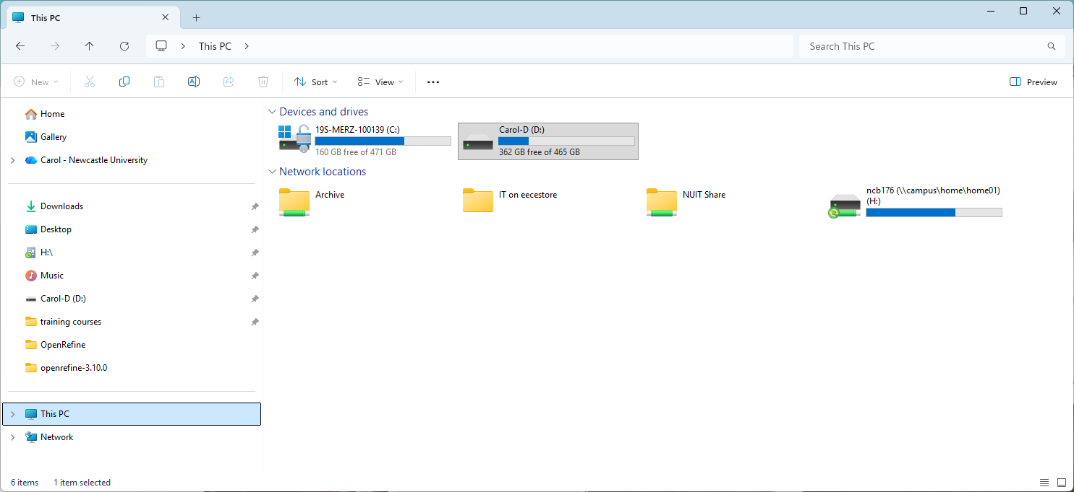
INTERFACE ELEMENTS
Anatomy of File Explorer
WINDOW SCHEMATIC
Navigation Pane (Left)
Jump quickly between key locations (Desktop, Downloads).
Address Bar (Top)
Shows current folder path and navigation trail.
Search Box (Caution)
Helpful, but never replace good structure with search.

Slide 13
DISCUSSION 3
Navigating the File Explorer
Confirm you can locate on your computer:
KEY COMPONENTS
REQUIRED ACTIONS
• Navigation pane
• Move between folders
• File listing area
• Expand and collapse folder trees
• Address bar
• Search box

Slide 14
EXERCISE
Challenge: Finding the Dataset
Download the lesson dataset and use File Explorer to:
1.
Open your Downloads folder.
2.
Locate the downloaded dataset archive.
3.
Open the dataset folder.
4.
Explore the contents without modifying anything.
5.
Identify at least three things that seem confusing or poorly organised.

Slide 15
CHALLENGE SOLUTION & REFLECTION
Evaluating the Inherited Dataset
Was It Clear Where Important Data Was?
What Information Was Missing?
No. Locating the core findings is hindered by messy naming and loose scripts.
• Documentation explaining dataset contents.
• Clear indication of which data file is authoritative.
Raw files, generated charts, and draft spreadsheets are indiscriminately lumped together.
• Separation between raw and processed outputs.

Slide 16
SUMMARY
Episode 1 Key Points
Data management is an essential part of research practice.
A well-organised project should be understandable to collaborators and to your future self.
Many common research frustrations arise from poor organisation and documentation.
File explorers provide a graphical way to navigate stored data.
Computers organise information using files and folders within a file system.
Understanding how files are organised is a foundation for good data management.
Notes:
.

Slide 17
LOOKING AHEAD
Next: Episode 2
Now that we have located the project files, we will begin improving their folder structure and establishing standard directory hierarchies.
Organising Project Folders

